Slide 1
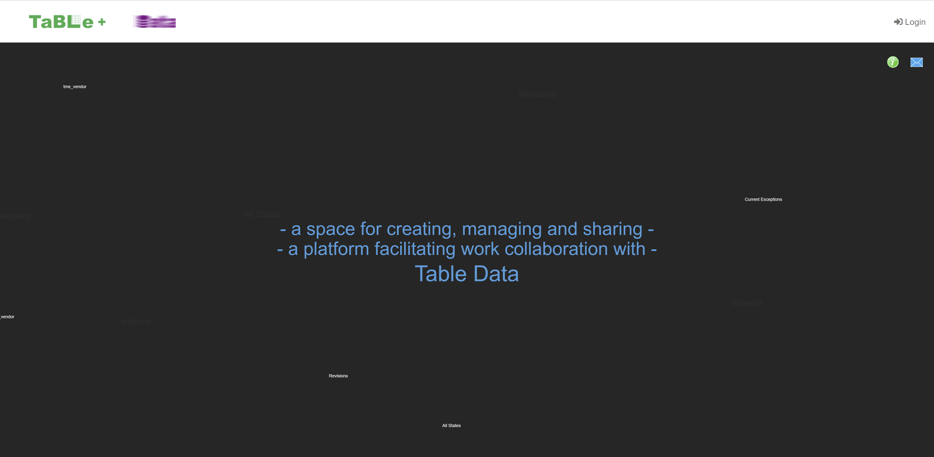
Brighter black background
A Space for Creating, Managing and Sharing -
A Platform Facilitating Work Collaboration with -
Tabulated Data

Slide 2
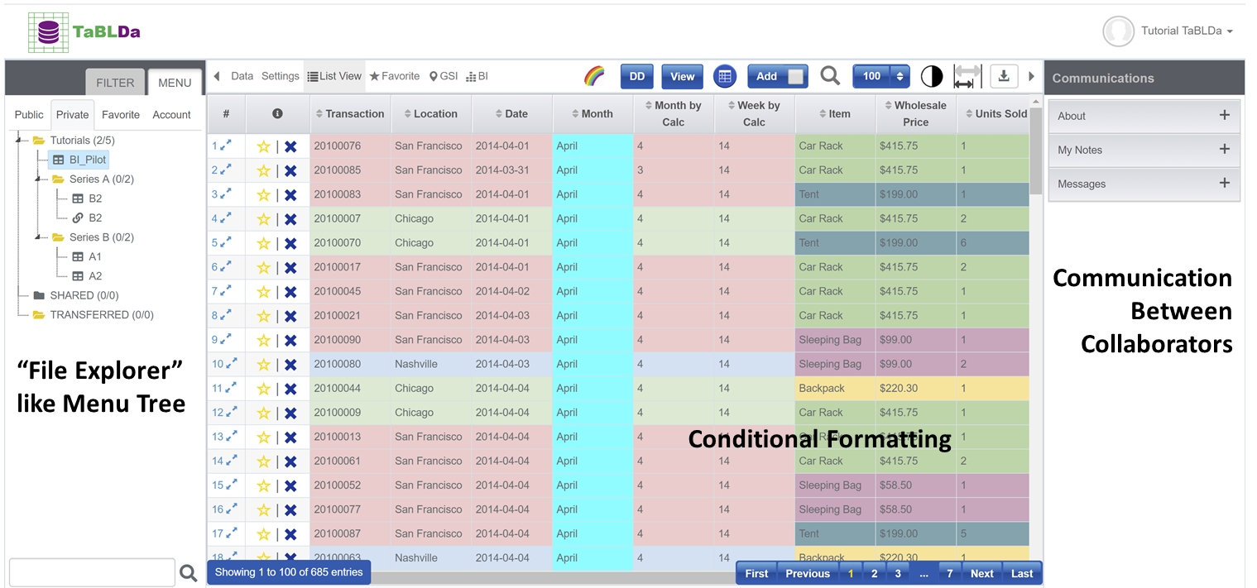
Like Excel
More than Excel
Powerful functions for
organizing, searching, filtering, updating, viewing and sharing tabulated data.

Slide 3
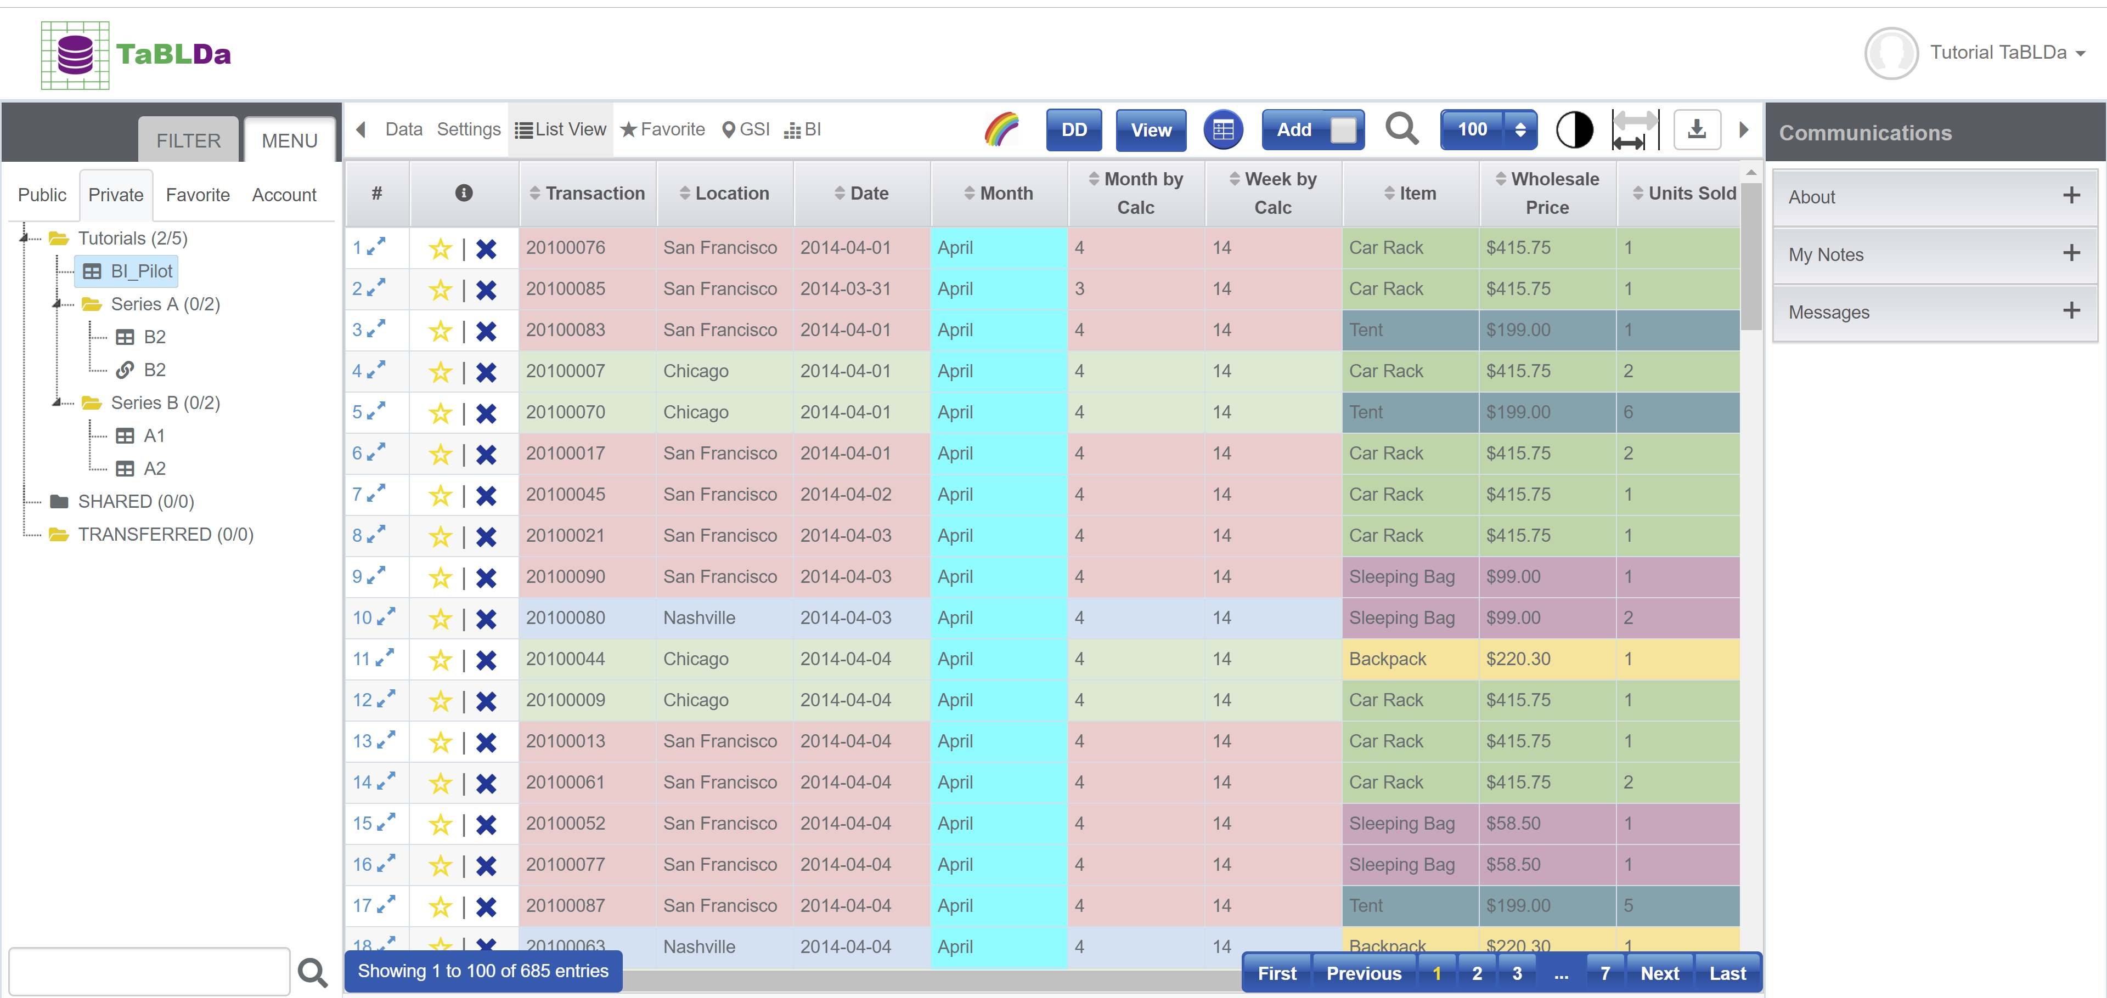
Communication Between Collaborators
“File Explorer” like Menu Tree
Conditional Formatting

Slide 4
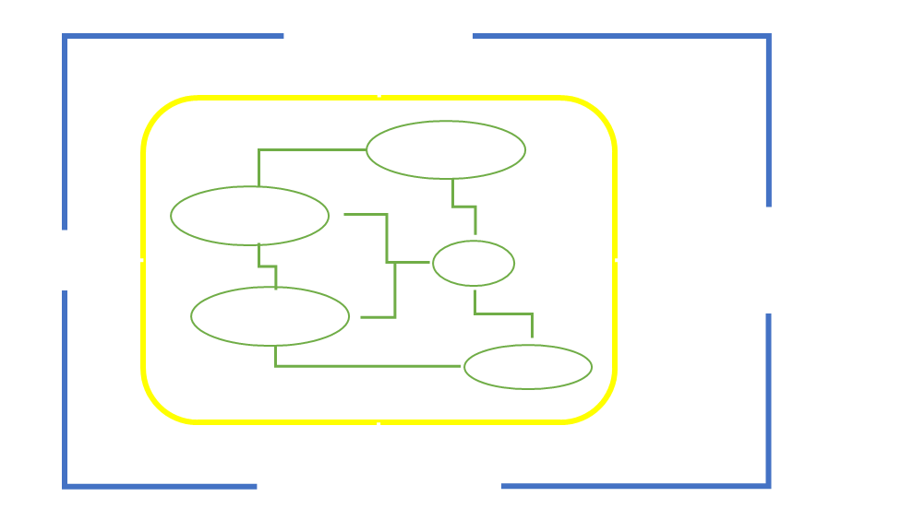
One Dataset
Many Relational Tables
Entire Team
All Together

Slide 5
Engineers
personnel
inventory
Business Development
Sales
cost
financials
services
Management

Slide 6
Columns of a
Column Group
Table-Centered Work Collaboration
w/ FULL Permission Control
Rows of a
Row Group

Slide 7
Table A
Dynamic Dropdown Lists
Linking
Relational Tables
to a HIGHER Level
Mutual Conditional Referencing
Cross-user Reference
… …
Check Data of Linked Tables
Based on Matching Conditions
Table B

Slide 8
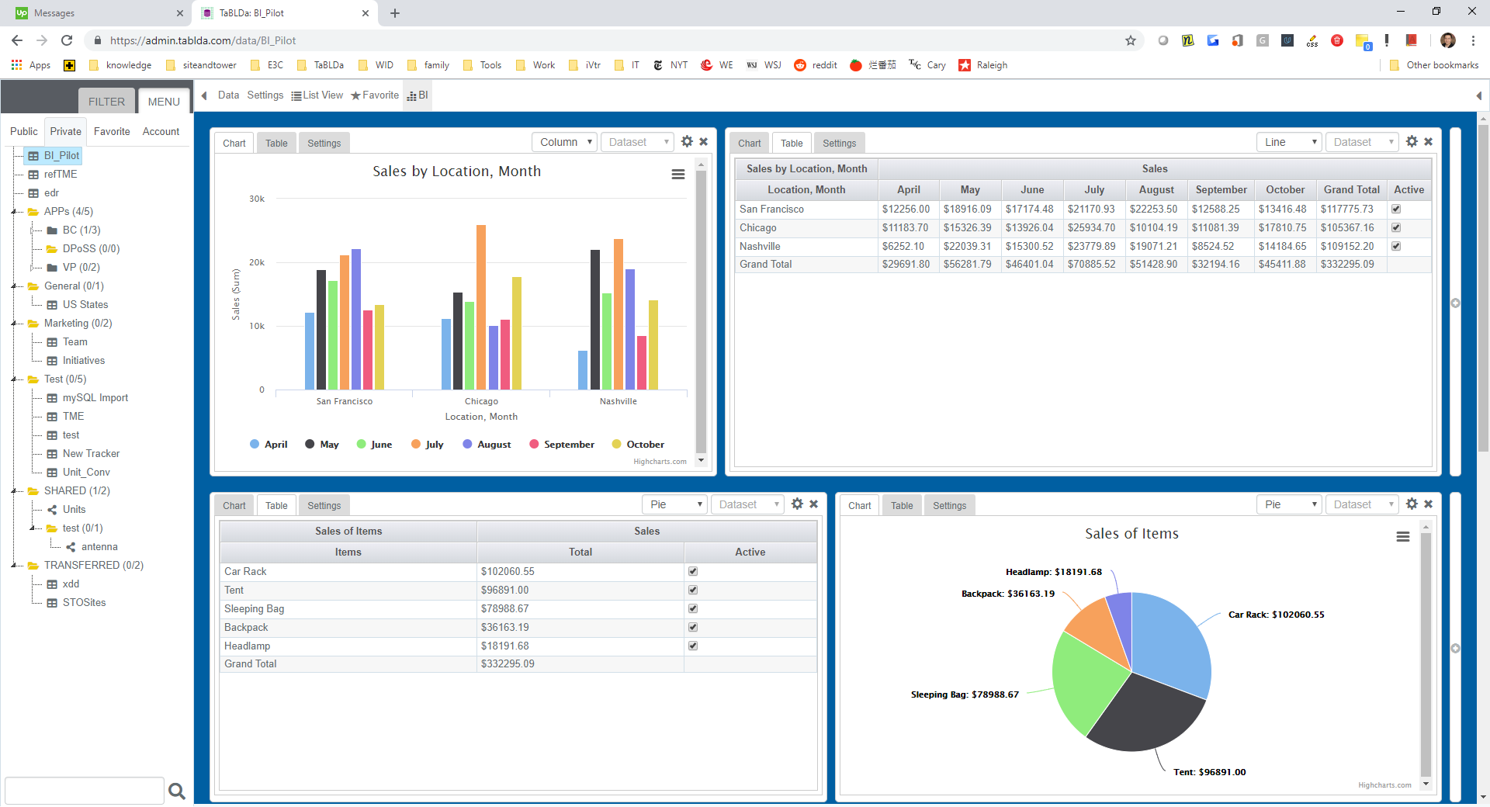
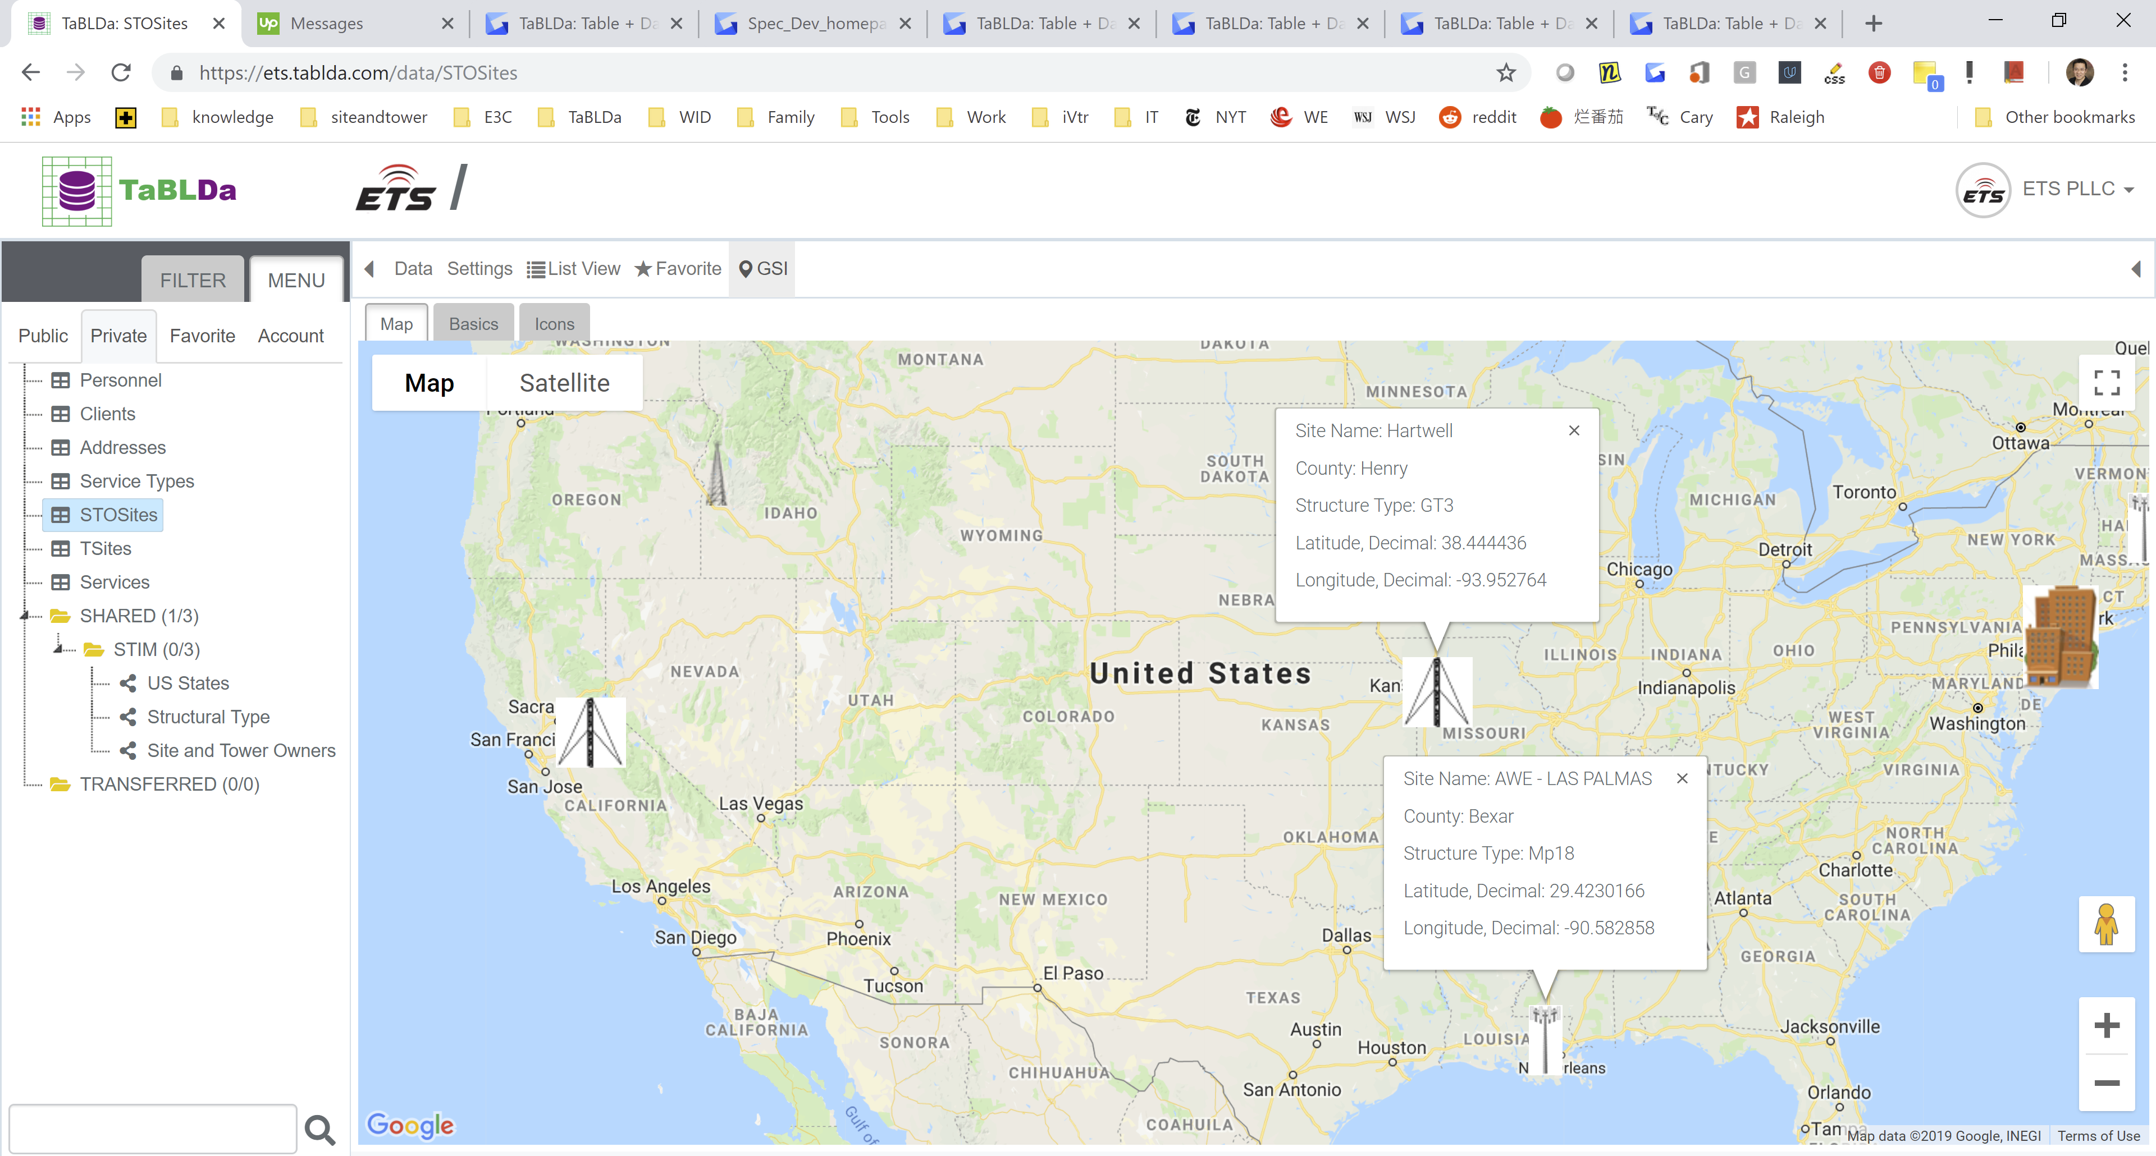
Business Intelligence (BI)
Define Your Own Dashboard
Much More Than Table and Data:
BI, GSI, & Apps
Customizable Geographic Spatial Information (GSI)

